Slide 1
Consumer and Producer Surplus
Chapter 4
Notes:
With a partner, discuss and be ready to share:
Are you in favor of legalizing the sale of kidneys? Why or why not?
Do you support the move to distribute organs in the United States based on “net benefit” rather than simply who’s been on the waiting list longest? Why or why not?

Slide 2
Learning objectives
Calculate consumer and producer surplus
Define and identify deadweight loss
When markets lead to efficiency
Types of market failures

Slide 3
SURPLUS
CONSUMER
& PRODUCER
Buyer’s maximum willingness to pay (WTP)
$20,000
CONSUMER SURPLUS
$
$
$
$
$
$
$
$
Consumer surplus (WTP – Price) = $2,800
Negotiated price = $17,200
PRODUCER SURPLUS
Producer surplus (Price – WTS) = $2,200
$15,000
Seller’s minimum willingness to sell (WTS)
SLIDE 3
Notes:
CONSUMER SURPLUS IS A FORM OF SAVING BECAUSE CONSUMERS ARE WILLING TO PAY MORE THAN THE MARKET PRICE.
PRODUCER SURPLUS IS A FORM OF EARNING BECAUSE BUSINESSES ARE WILLING TO PROVIDE A GOOD OR SERVICE BELOW THE MARKET PRICE.

Slide 4

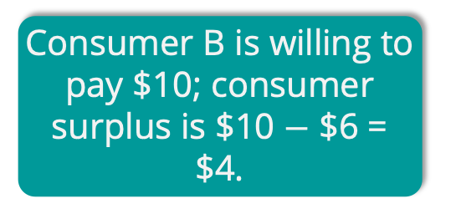
INDIVIDUAL CONSUMER SURPLUS
Consumer A is willing to pay $11...
P
12
S₀
11
10
Consumer A’s surplus is $11 $−$ $6 = $5.
9
8
7
6
Consumer B is willing to pay $10; consumer surplus is $10 $−$ $6 = $4.
…but the price is just $6.
D₀
And so on…
Q
0
1 2 3 4 5 6
SLIDE 4

Slide 5
TOTAL CONSUMER SURPLUS
P
12
S₀
11
10
The sum of all individual consumer surplus
9
8
consumer surplus
7
6
The area below the demand curve and above the price
D₀
Q
0
1 2 3 4 5 6
SLIDE 5

Slide 6


INDIVIDUAL PRODUCER SURPLUS
P
S₀
The price is $6…
Producer A’s surplus is $6 $−$ $2 = $4.
6
Producer B is willing to sell at $3; producer surplus is $6 $−$ $3 = $3.
5
4
…but producer A is willing to sell at $2.
3
2
And so on…
D₀
1
Q
0
1 2 6
SLIDE 6

Slide 7
TOTAL PRODUCER SURPLUS
P
S₀
The sum of all individual producer surplus
6
The area above the supply curve and below the price
producer surplus
1
D₀
Q
0
6
CHAPTER 4
SLIDE 7

Slide 8
TOTAL SURPLUS
When markets are efficient, TS is MAXIMIZED!
TS = CS + PS
Notes:
Total surplus is maximized with markets: Markets are efficient.
Three ways you might (unsuccessfully) try to increase the total surplus
reallocate consumption among consumers
reallocate sales among sellers
change the quantity traded

Slide 9
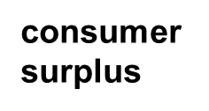
WHEN PRICES EXCEED EQUILIBRIUM
Price rises to $400; quantity falls to 10.
P
S₀
400
New consumer surplus
300
Transferred to producers
producer surplus
Deadweight loss
D₀
Q
0
10
20
SLIDE 9

Slide 10
WHEN PRICES ARE BELOW EQUILIBRIUM
Price falls to $200; quantity falls to 10.
P
S₀
Deadweight loss
300
Transferred to consumers
producer surplus
200
New producer surplus
D₀
Q
0
10
20
SLIDE 10

Slide 11
Efficiency of Markets
Competitive markets are usually efficient:
Allocate consumption to the potential buyers who most value it.
Allocate sales to potential sellers who most value right to sell the good (e.g., who have the lowest cost).
They ensure that all transactions are mutually beneficial
Notes:
Mutually beneficial Every consumer who makes a purchase values the good more than every seller who makes a sale.

Slide 12
Why markets typically work so well
Well-functioning markets are effective because of:
Property rights: the rights of owners of valuable items, whether resources or goods, to use those items as they choose.
Economic signals: any piece of information that helps people make better economic decisions.
Notes:
Prices translate complex information into an easy signal for producers:
Profits rise in industries when consumers want more of that industry’s products.
Profits decline in industries when consumers want less of that industry’s products.
The high price of ice in post-Katrina New Orleans made it more attractive for firms to provide ice where society needed it most.

Slide 13
Four sources of market failures
Markets will not be efficient in the presence of market failures!
Lack of competition
Information not shared by all parties
Existence of external benefits/costs (externalities)
Existence of public goods

